Slide 1
Wind energy

Slide 2




About us
Fawn Zou
Lee Gao
Steve Darby
Vien Vo

Slide 3
Questions
Requirements for suitable location for wind farms.
Which states have most locations suitable for wind farms?
Where to build wind farm?
Which states benefit most from wind energy?

Slide 4
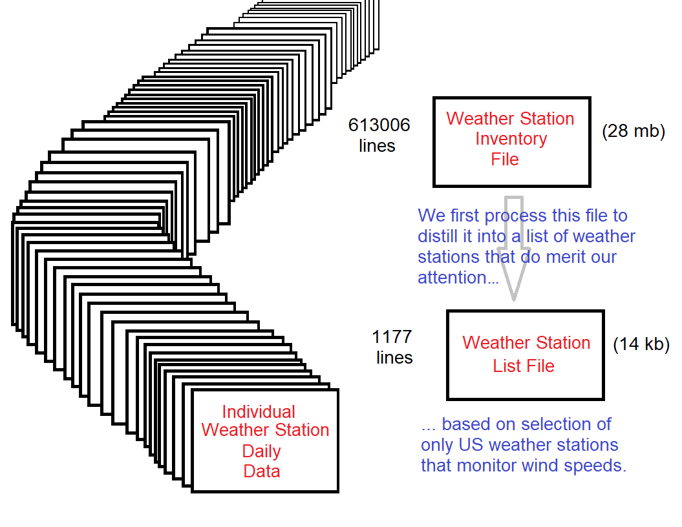
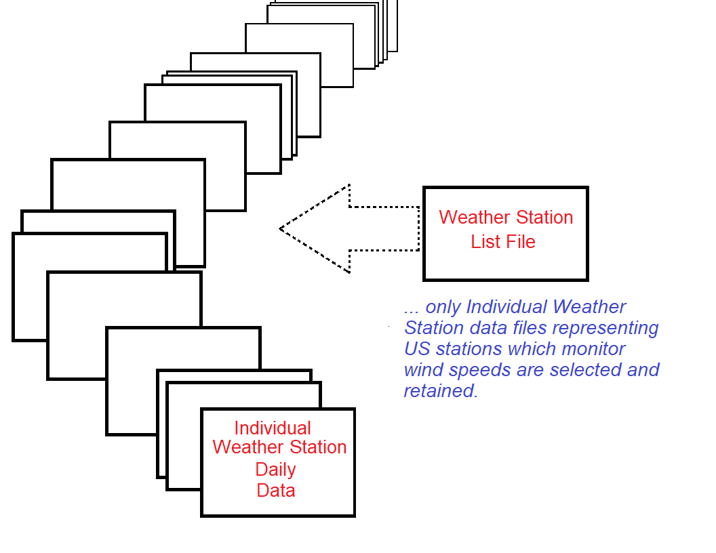
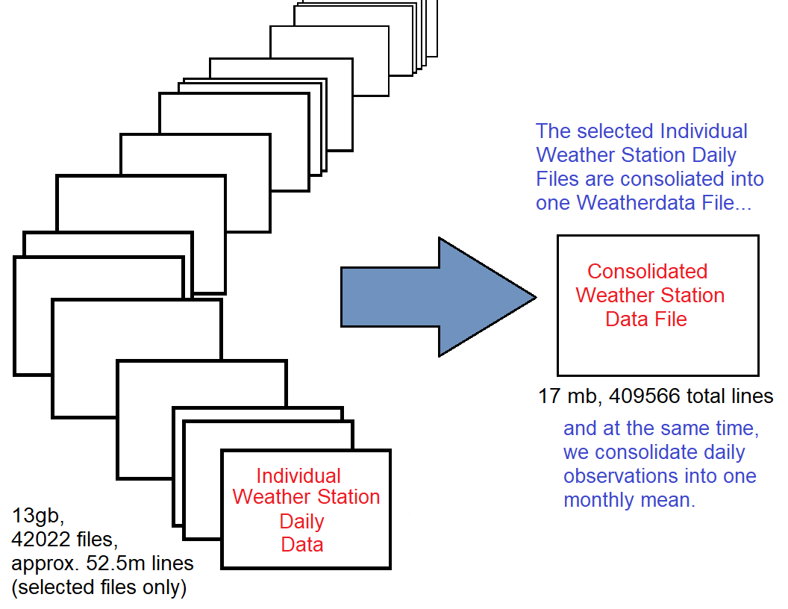
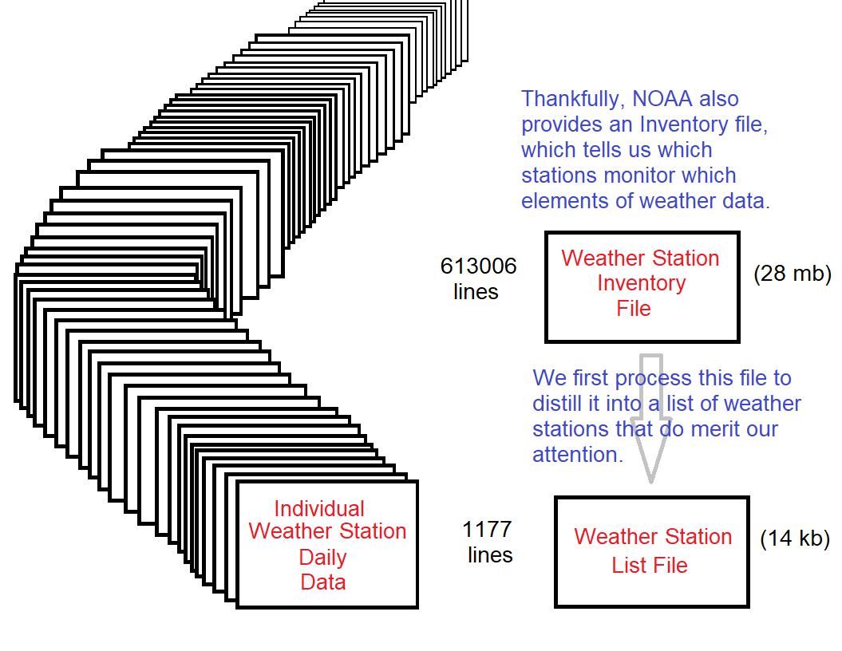
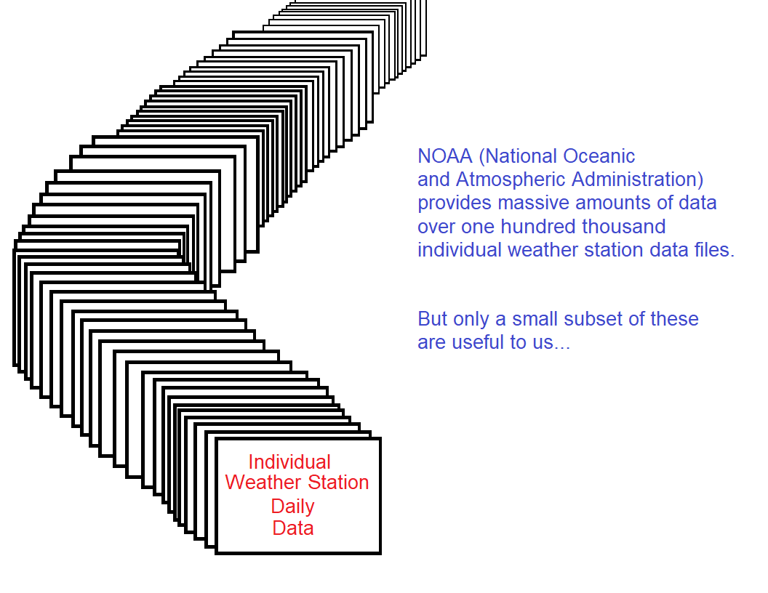
Data gathering and cleaning

Slide 5
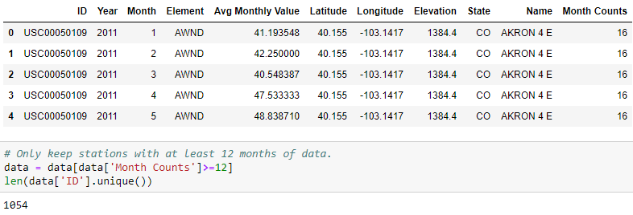
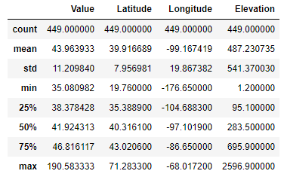
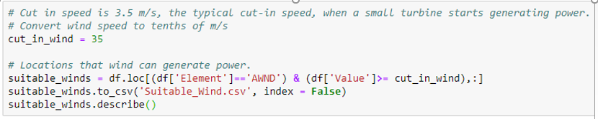
Requirements for wind farms.
8 kph (2 m/s) minimum is required to start rotating most small wind turbines.
12.6 kph (3.5 m/s) is the typical cut-in speed, when a small turbine starts generating power.
36–54 kph (10–15 m/s) produces maximum generation power.

Slide 6
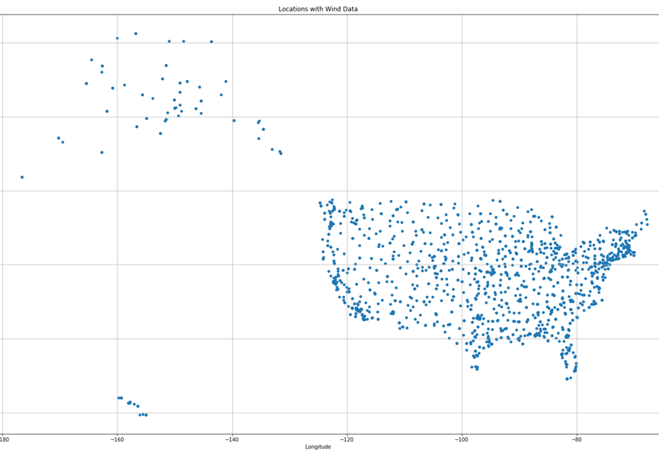
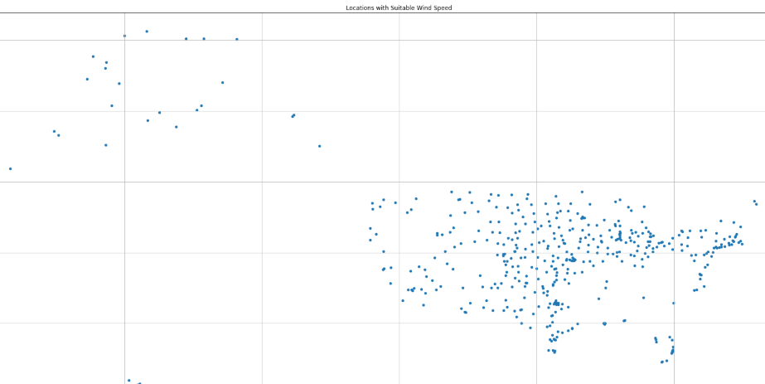
U.s. locations with wind data
U.s. locations suitable wind speed

Slide 7
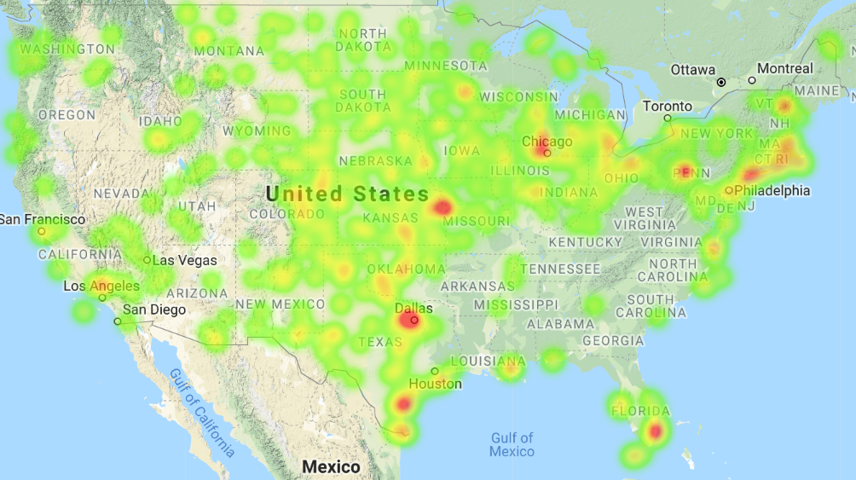
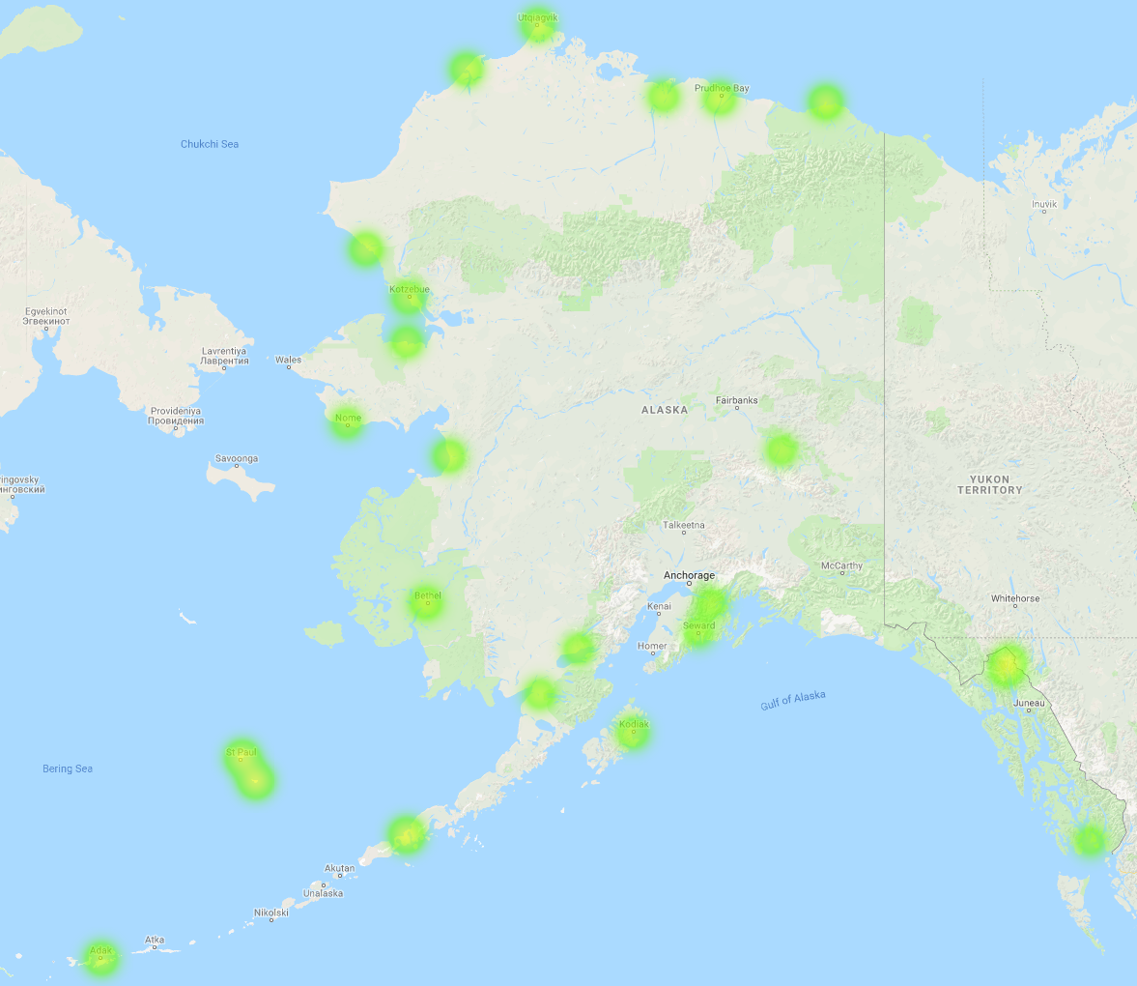
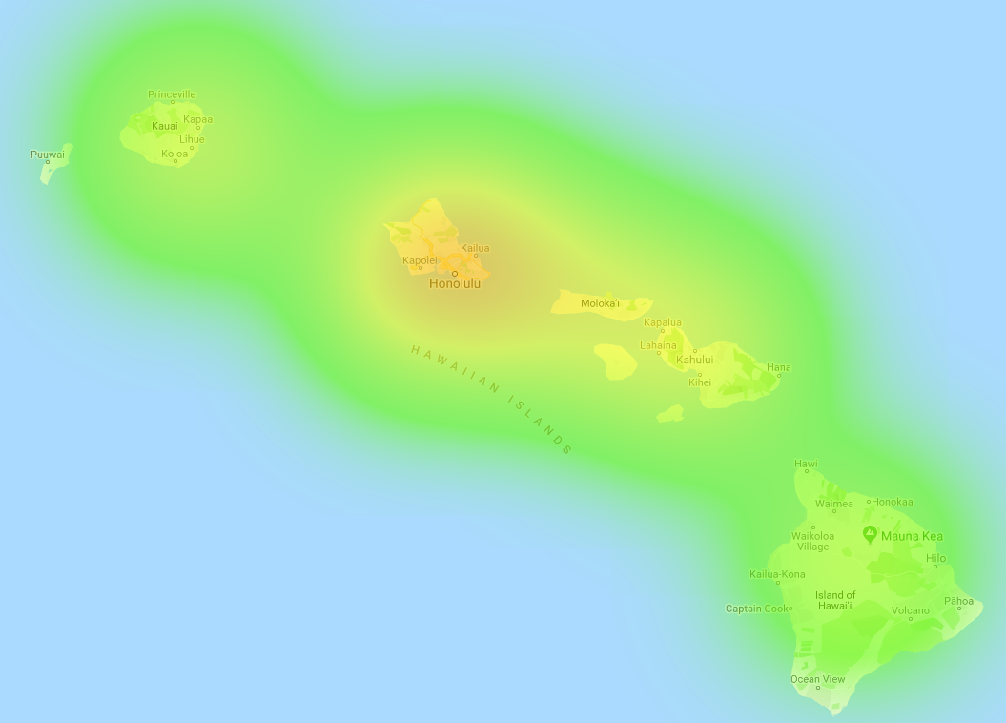
Suitable locations for wind farms?

Slide 8
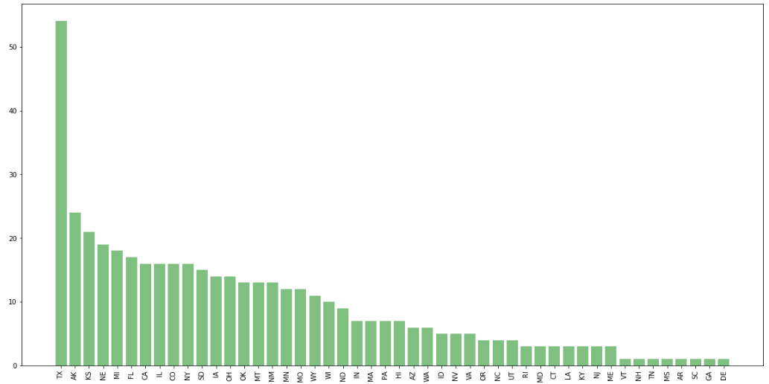
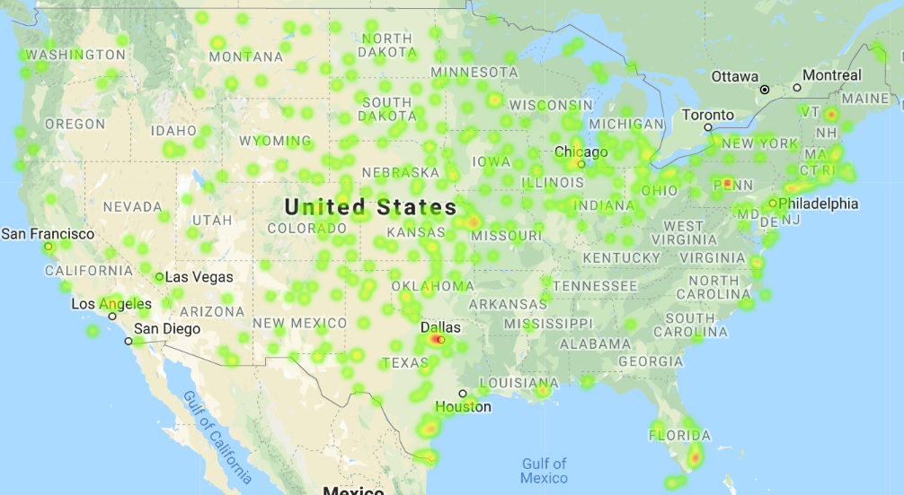
List of States with suitable wind speed

Slide 9

Wind Turbine Locations with Climate and Health Benefits
A wind turbine in West Virginia displaces twice as much carbon dioxide and seven times as much health damage as the same turbine in California.”” Kyle Siler-Evans, Ph.D. researcher from Carnegie Mellon University .

Slide 10
We Investigate the Coal Consumption in Each State in 2014
Dataset : United States Energy, Census, and GDP 2010-2014.csv
(the 2010-2014 US Energy, Census, and Economic data as described in the data set description, from U.S Energy Information Administration)
Here I only retrieve Coal total consumption for each state in 2014

Slide 11
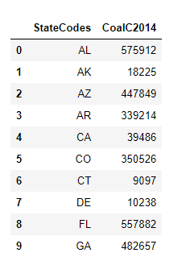
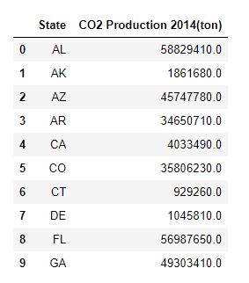
Coal total consumption
in billion BTU in 2014
Carbon Dioxide Production
Btu :British thermal units
Coal emits about 204.3 pounds of carbon dioxide per million Btu when completely burned.
2000 lb/ 1 tons
“CoalC2014” * 204300/2000 = “CO2 Production 2014(ton)”

Slide 12
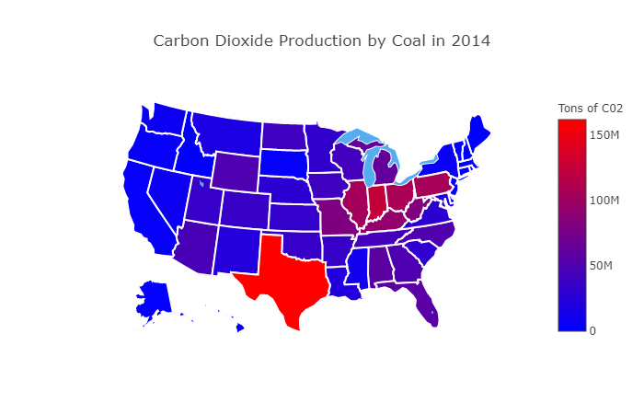

Slide 13
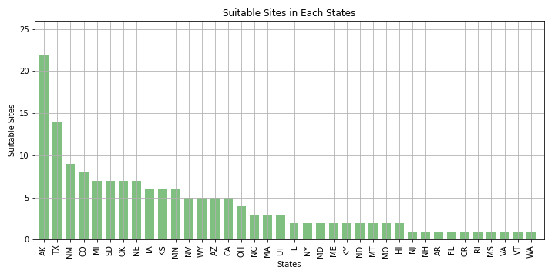
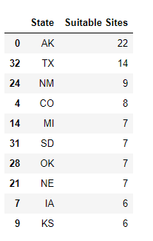
The Suitable Sites in Each States

Slide 14
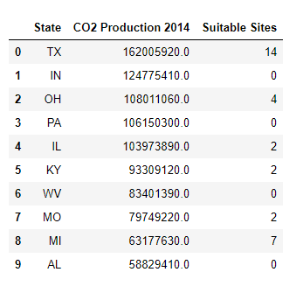
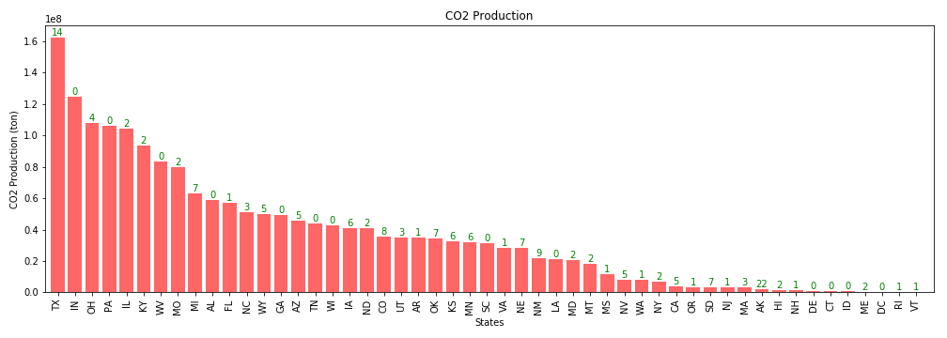
Combine Two Datasets
Wind turbines result in greater health and climate benefits in areas
of the country such as Texas, Ohio, Illinois, Kentucky.

